Slide 1

Student Registration Management System
2100030823- Raja Rajeswari. M
2100030254- Jenny Meshaiah. K

Slide 2
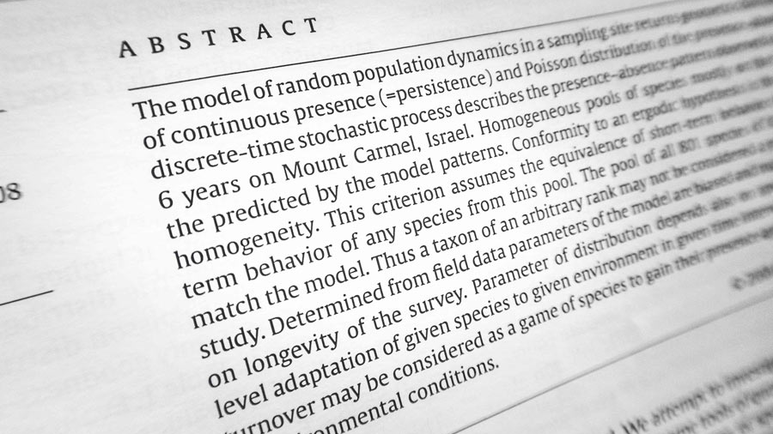
Abstract
With the advent of Information Technology in the last decade, the major focus has shifted from manual systems to computerized systems. Various systems viz. railway reservation, hospital management etc. involving manual work have been automated efficiently. Student course registration process in colleges involve filling registration forms manually, getting it signed by respective subject teachers, and then getting the documents acknowledged from the concerned Advisors, College Deans and Accounts Officers, respectively. Finally, the registration forms are submitted in the Administrative Branch. As is evident, this process is very laborious and time consuming. An Online Student Course Registration System has been developed to simplify the current manual procedure. This system has been developed using Python and tkinter package. Tkinter is mainly used for GUI in pyhton programming

Slide 3

Introduction
The Student Management System Project in Python is a simple console-based system which is very easy to understand and use.
Talking about the system, it contains basic functions which include Add students, view students, search students and remove the student.

Slide 4

At which area it is used
Student Registration management system is a kind of management information system can not only record the information for student registration.It is widely used in universities and schools for some universities it was used as a browser-based application and back-end software like SQL

Slide 5

Existing systems
The existing system of registration requires many documents and application forms to be filled out. Data must be repeatedly entered at each stage of the process and multiple files are made for each student. Documents are verified with multiple copies made for record and the testing process is conducted independently which again compounds the paperwork

Slide 6

Requirements
Windows Operating System
Ram 8gb
Python 3.8.10
Pycharm community edition

Slide 7

THANK YOU

